Slide 1
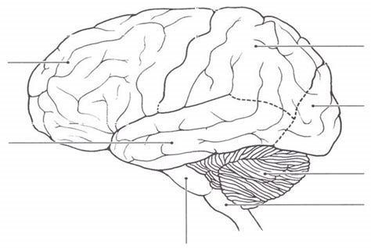
Daily Review
The brain processes internal and external information for the body.
It consists of the cerebrum, cerebellum, and brain stem.
What vital functions does the brain stem control?

Slide 2
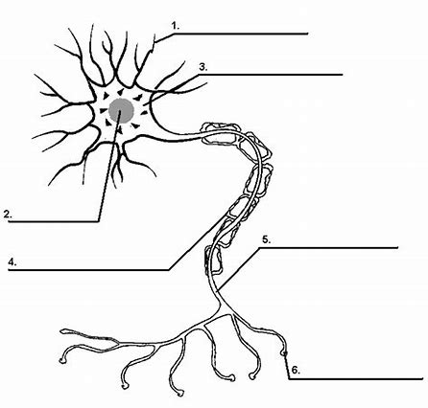
Daily Review
Neurons carry electrical messages, called nerve impulses, from one part of the body to another at very high speed.
Match each of the following parts of a neuron to the position on the diagram.
Axon
Dendrite
Cell Body
Myelin Sheath
Synaptic Terminal
Nucleus
Is this a motor neuron, sensory neuron, or interneuron? Explain your choice.

Slide 3
Stimulus Response Models
Year 9 Biology

Slide 4
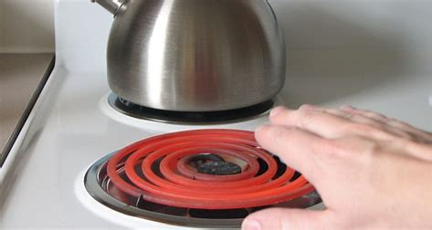
Learning Objectives
CFU
What are we going to learn?
Describe examples of stimulus response.
Explain difference between reflex actions and normal stimulus-response.
Activate Prior Knowledge
Our body functions without our conscious control. It also helps to protect us from harm.
Think, Pair, Share:
What happens when you accidentally touch a something hot, like a stove?

Slide 5
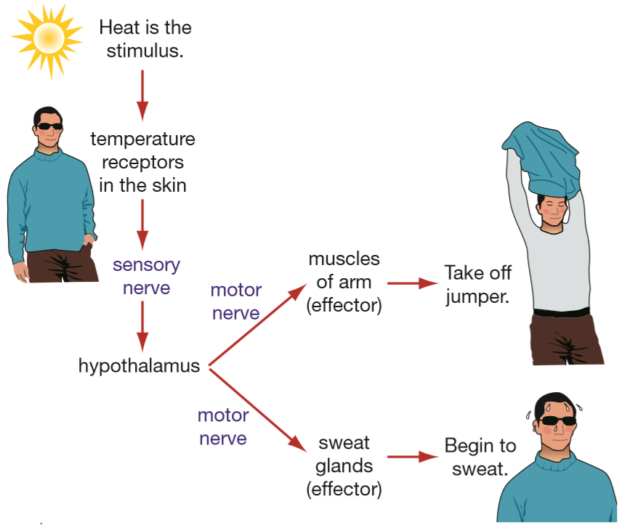
Concept Development
CFU 1
What is the stimulus when you feel cold?
CFU 2
Which receptors detect the change in temperature?
Stimulus Response Model
The stimulus response model describes how messages are sent through the body.
It is summarised by:
Stimulus → Receptor → Control centre → Effector → Response
CFU 3
Where is the message processed?
CFU 4
Where is the response sent?
CFU 5
Where is the response sent?

Slide 6
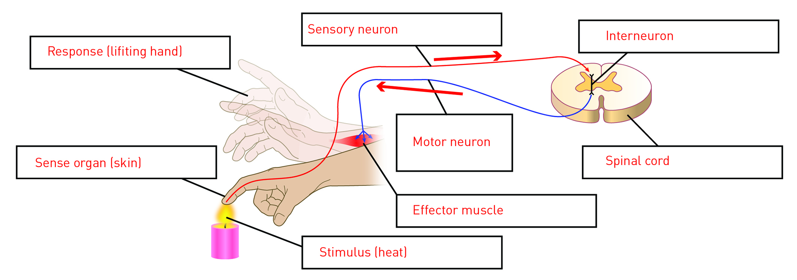
Concept Development
CFU 1
Which part of the stimulus-response model are the muscles? Explain your choice. Receptor Response Effector
Stimulus Response Model
Stimulus → Receptor → Control centre → Effector → Response
Stimuli in the environment are detected by receptors in our sense organs.
Sensory neurons then pass nerve impulses to the CNS where interneurons gather the processed information.
Nerve impulses are then returned to the PNS via motor neurons, to the muscles and organs.
Muscles/organs then work to effect a response from the body.

Slide 7
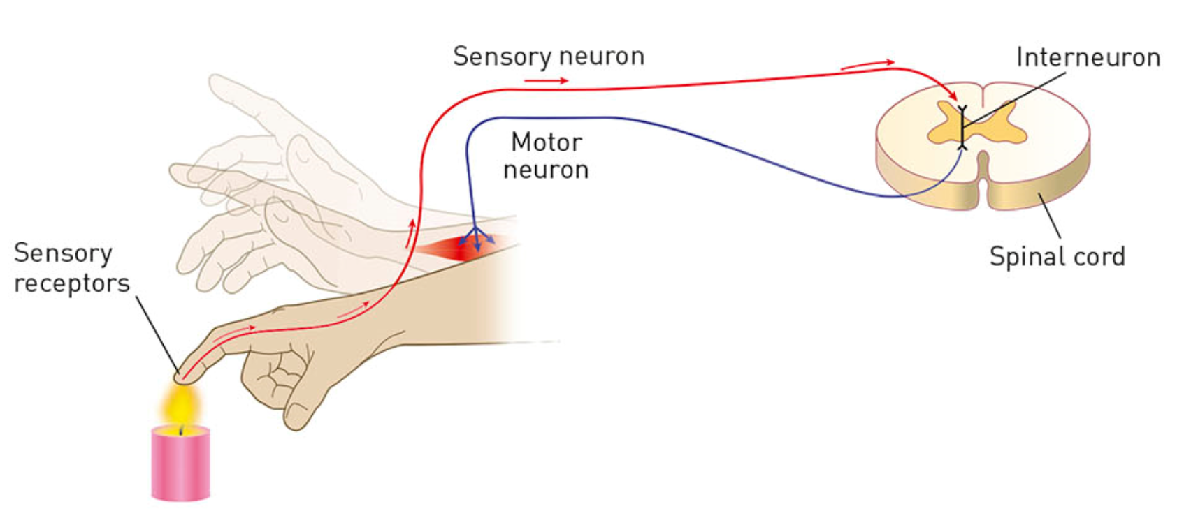
Concept Development
CFU 1
Which two locations is the message sent in a reflex action?
Reflexes
A reflex action is an involuntary, almost instantaneous movement in response to a stimulus.
During a reflex action, the sensory neuron carries the message from the receptor to the spinal cord.
The interneuron in the spinal cord then sends two messages at the same time:
One to the brain
One to the motor neuron and muscles
This ensures the muscles are moving at the same time as the brain received the message about the stimulus.
This makes reflex actions faster than usual responses.
CFU 2
Why are reflex actions faster than usual responses?

Slide 8
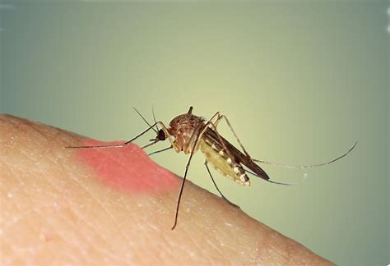
Skill Development/Guided Practice
Reminder
Stimulus → Receptor → Control centre → Effector → Response
CFU 1
What is the stimulus?
Describe the stimulus response model for scratching an itchy mosquito bite on your arm.
CFU 2
What is the receptor?
CFU 3
What is the control centre?
Itchy mosquito bite
CFU 4
What is the effector?
Touch receptors in the skin
Brain
CFU 5
What is the response?
Muscles in the arm
Scratching the bite

Slide 9
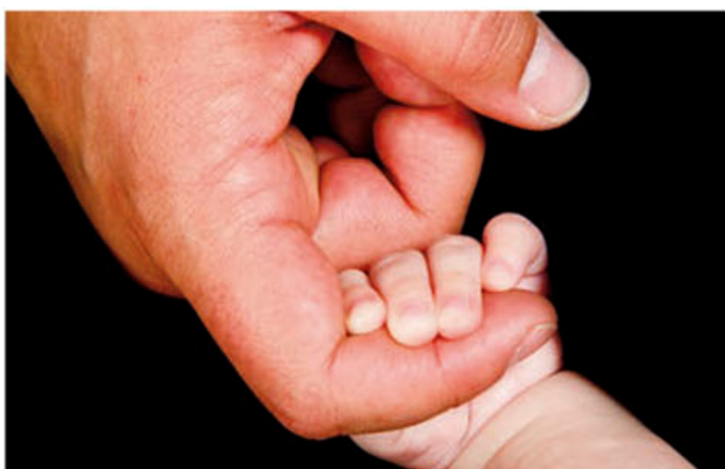
Skill Development/Guided Practice
Reminder
Stimulus → Receptor → Control centre → Effector → Response
CFU 1
What is the stimulus?
The grasp reflex occurs when an object is placed on a baby’s palm. Their fingers curl over and grasp it.
Describe the stimulus response model in this situation.
CFU 2
What is the receptor?
CFU 3
What is the control centre?
Object touching the palm
CFU 4
What is the effector?
Touch receptors in the skin
Spinal cord
CFU 5
What is the response?
Muscles in the arm
Curling the fingers

Slide 10

Skill Development/Guided Practice
Reminder
Stimulus → Receptor → Control centre → Effector → Response
CFU 1
What is the stimulus?
Describe the stimulus response model for when someone calls your name.
CFU 2
What is the receptor?
CFU 3
What is the control centre?
Sound of someone’s voice
CFU 4
What is the effector?
Mechanoreceptors in the ear
Brain
CFU 5
What is the response?
Muscles in the neck
Turning your head

Slide 11
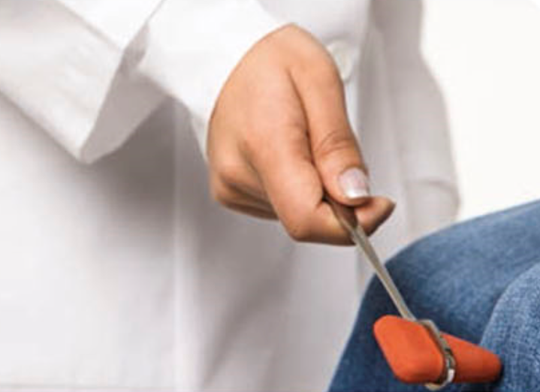
Skill Development/Guided Practice
Reminder
Stimulus → Receptor → Control centre → Effector → Response
CFU 1
What is the stimulus?
The knee-jerk reflex occurs when the small section below the kneecap is stimulated with a tap. The foot will kick out.
Describe the stimulus response model in this situation.
CFU 2
What is the receptor?
CFU 3
What is the control centre?
Tapping below the kneecap
CFU 4
What is the effector?
Touch receptors in the skin
Spinal cord
CFU 5
What is the response?
Muscles in the leg
Kicking the foot

Slide 12

Skill Development/Guided Practice
Reminder
Stimulus → Receptor → Control centre → Effector → Response
CFU 1
What is the stimulus?
Describe the stimulus response model for when you step out into bright sunshine from a dark room.
CFU 2
What is the receptor?
CFU 3
What is the control centre?
Bright sunlight
CFU 4
What is the effector?
Photoreceptors in the eye
Brain
CFU 5
What is the response?
???
???

Slide 13
Relevance
Our bodies are complex organisms that are constantly responding to changes in the external and internal environment.
Knowing about the nervous system and how it elicits responses from the body helps you understand how our body coordinates its movement and internal environment to protect us from harm and help us to survive.

Slide 14
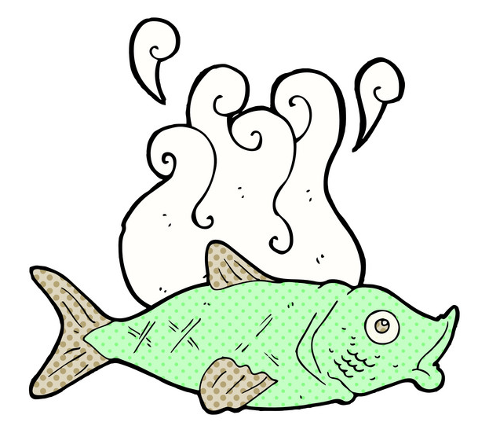
Skill Closure
Reflexes occur without waiting for the brain to respond. What could happen if we did not have reflexes?
Skill Closure
Put the components of the stimulus response model in the correct order.
A Effector
B Response
C Control Centre
D Stimulus
E Receptor
Reminder
Stimulus → Receptor → Control centre → Effector → Response
Skill Closure
Describe the stimulus response model for when you smell rotting fish as you pass a bin.

Slide 15
Independent Practice
Complete the Stimulus Response worksheet, either on paper copy or your device.
Marigold
Rafflesia
Trumpet Vine
Cactus
Jasmine
Bottlebrush

